Slide 1
Predicting The Unpredictable
Leveraging Deep Learning for Terrorism Trend Analysis -
OR-690 (Prof Tianshu Feng)
Author:Oluwasegun Adegoke

Slide 2
Introduction
Predictive analytics, a powerful branch of advanced data analysis, leverages historical data to make informed predictions about future events. In my case, we’re diving into the realm of counterterrorism.
Who are the beneficiaries: Security agencies, policymakers, and researchers, offering insights into terrorism trends, potential hotspots, and the characteristics of terrorist attacks to inform effective counter-terrorism strategies.

Slide 3
My Goal
Developing a deep learning model that scrutinizes the annals of terrorist incidents, aiming to anticipate trends and uncover patterns. Armed with this knowledge, we can take preventative measures to safeguard lives and communities.
Problem Statement
Expectation of project
-Inputs: Features from the global terrorism database, such as attack dates, locations, types, target types, responsible groups, and casualties.
-Outputs: Predictions on trends in terrorist activities (increase, decrease, stable) and identification of nature of future attacks.
-The task involves predicting complex and evolving terrorism activities influenced by a vast array of factors.
-It requires processing large volumes of historical data to identify patterns, a challenging endeavor that involves sophisticated deep learning and data analysis techniques.

Slide 4
Approach
Predictive
Analytics
Dataset was source from Global Terrorism Database (GTD)
Exploratory Data Analysis (EDA): Before diving into Deep Learning modeling, an in-depth exploratory analysis will be conducted to understand the underlying data structure,, and identify significant patterns and correlations.
Time-Series Analysis: Utilizing Long Short-Term Memory (LSTM) networks to capture the temporal patterns of terrorist activities, recognizing dependencies and trends over time that may not be apparent through traditional analysis methods.
Graph Neural Networks (GNNs): Employing GNNs to understand how can a GNNs can be utilized to predict the type of terrorist attacks based on the relational data of locations, dates, and attack types. This includes creating a graph where nodes represent different entities such as locations, dates, and groups, and edges represent relationships like proximity, similarity in attack methods, or common targets.

Slide 5
Dataset Overview
Size: The dataset initially contained 170,350 rows and 135 columns before cleaning and selection. After the necessary preprocessing, it was reduced to 165,744 rows and 22 columns.
Time Period: The dataset spans from 1970 to 2016, with a median year of 2008, indicating a balanced distribution across recent decades.
Main Features Used:
Date
Attack Type
Target_type
Weapon_type
Country
Latitude and Longitude
Target Variables:
Attack_type: The primary target variable.
Attack Occurrence: Another key target variable.

Slide 6
Handling Missing Values
To ensure data consistency and completeness, I addressed missing values using the following techniques:
Categorical Features:
city: Filled with “Unknown”.
Target_type: Filled with “Other”.
claimed: Filled with 0.
Numerical Features:
latitude: Filled with the mode of the column.
longitude: Filled with the mode of the column.
Dropped Rows:
Rows with missing values in Attack Type or Weapon Type were removed.

Slide 7
Additional Columns
DaysSinceLatt:
Calculates the number of days since the last attack in the same region.
Created using the groupby function on the Region column and the diff function on the Date column.
IsHoliday:
Indicates whether the attack date corresponds to a holiday in the country.
Created using a custom function, get_holidays, which retrieves holiday information based on the country code.
The resulting column assigns a value of 1 if the date is a holiday and 0 otherwise.

Slide 8
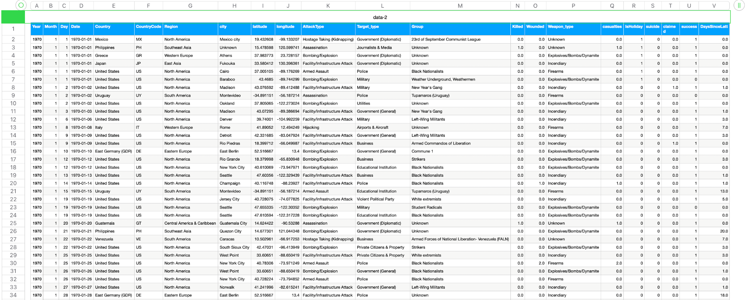
Dataset
Notes:
Here's a look at the dataset. when we used this dataset, we dropped the first four columns to ensure the models flexibility. This comprehensive view is crucial for accurate predictions.

Slide 9
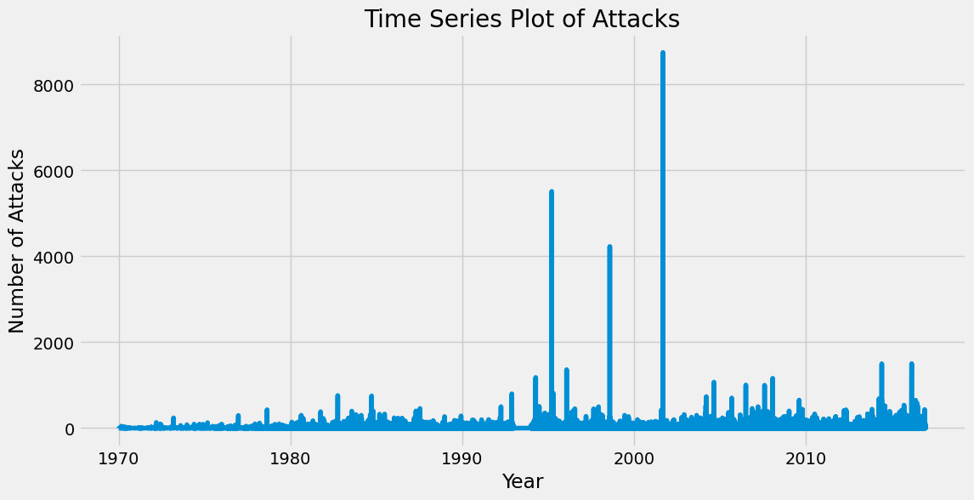
Notes:
These scatter plots compare our models' predicted goals against actual goals. Model 1's plot shows potential, but Models 2 and 3 demonstrate greater accuracy, as seen in the close clustering around the best-fit line, with Salah's prediction being particularly accurate.

Slide 10
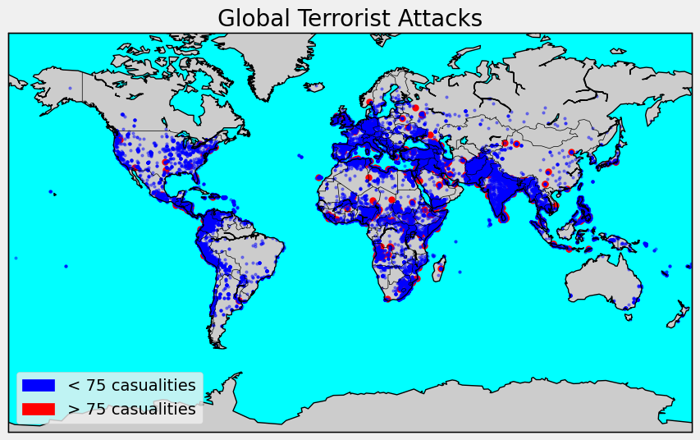
Notes:
These scatter plots compare our models' predicted goals against actual goals. Model 1's plot shows potential, but Models 2 and 3 demonstrate greater accuracy, as seen in the close clustering around the best-fit line, with Salah's prediction being particularly accurate.

Slide 11
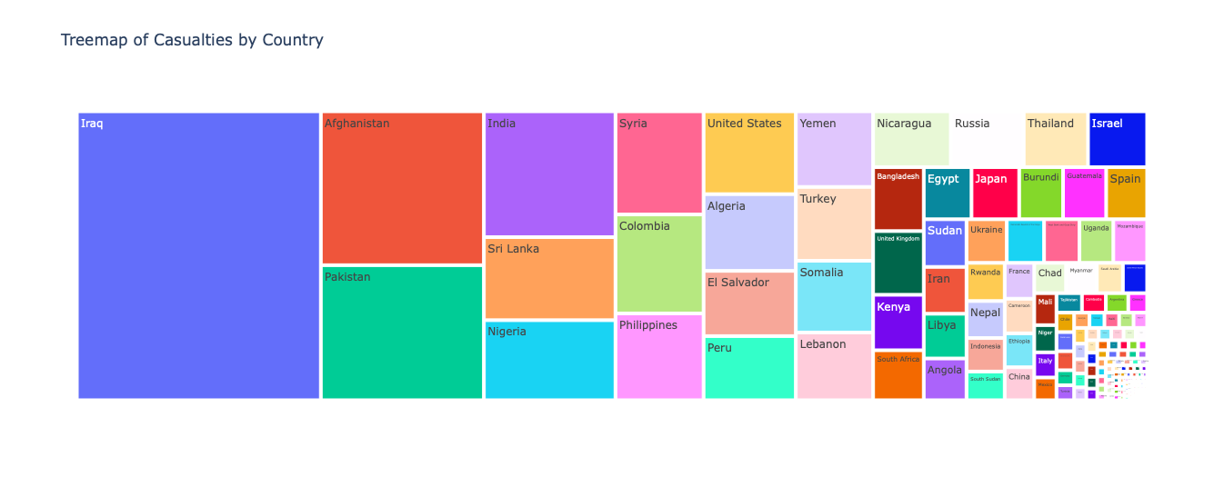
Notes:
These scatter plots compare our models' predicted goals against actual goals. Model 1's plot shows potential, but Models 2 and 3 demonstrate greater accuracy, as seen in the close clustering around the best-fit line, with Salah's prediction being particularly accurate.

Slide 12
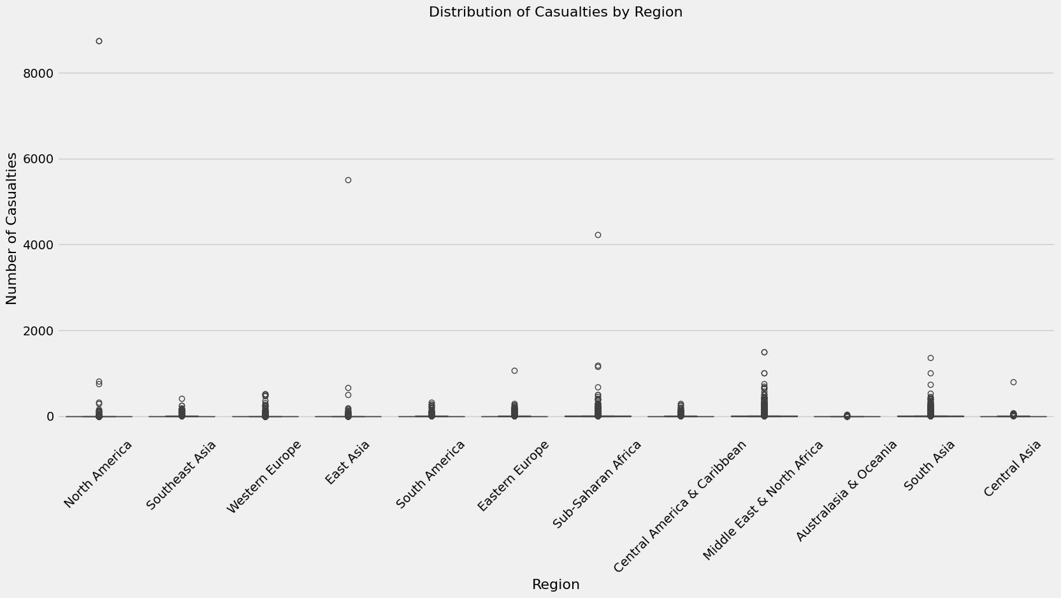
Notes:
These scatter plots compare our models' predicted goals against actual goals. Model 1's plot shows potential, but Models 2 and 3 demonstrate greater accuracy, as seen in the close clustering around the best-fit line, with Salah's prediction being particularly accurate.

Slide 13
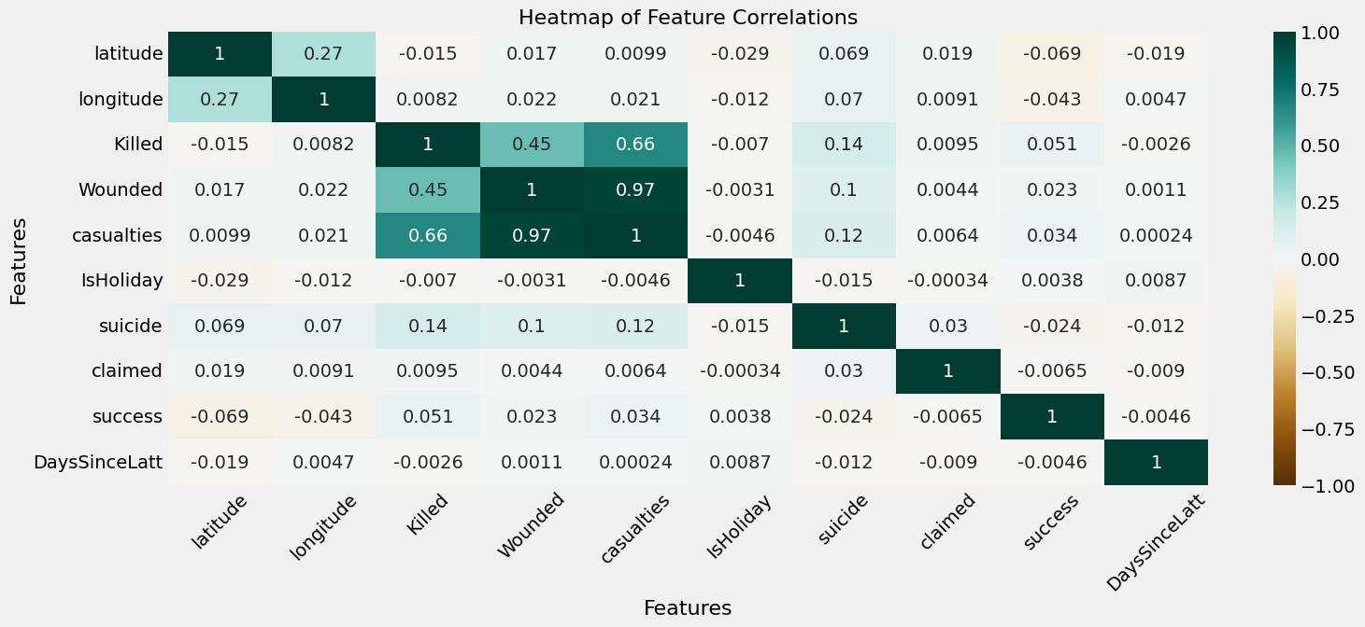
Notes:
These scatter plots compare our models' predicted goals against actual goals. Model 1's plot shows potential, but Models 2 and 3 demonstrate greater accuracy, as seen in the close clustering around the best-fit line, with Salah's prediction being particularly accurate.

Slide 14
Core Methods
I leveraged Time-Series Analysis, which utilizes temporal data to comprehend and forecast patterns in terrorism activities over time. Furthermore, we explored Graph-Based Analysis, employing graph theory to uncover intricate interdependencies between entities such as locations, events, and dates.
Long Short Term Memory
Graph Neural Network
Description: Variants of recurrent neural networks (RNNs) that are capable of learning order dependence in sequence prediction problems.
Why Suitable: Effective in capturing temporal dependencies and patterns in time-series data, essential for predicting the timing and evolution of terrorist attacks.
Description: A type of neural network that operates directly on graphs, enabling the model to learn from the structural information of data.
Why Suitable: Allows integration of relational data (e.g., connections between locations, attack types), which is critical for understanding how terrorist networks operate and influence different regions and entities.

Slide 15
Long Short Term Memory
Data Structuring for Modeling
Data Normalization and Sequencing:
Sorted data to ensure the time series integrity.
Created cyclical features for 'Month' and 'Day' to capture seasonal trends
Introduce lag features for 'Killed' and 'Wounded'
Implement rolling window statistics (mean, median, standard deviation)
Aggregate data by week and month for trend analysis
Scale features using MinMaxScaler to normalize data between 0 and 1
Create sequential data batches to feed into LSTM
Split the normalized data into training and testing sets, using a historical cut-off point to validate model predictions against actual outcomes.
Lagged or time-shifted features, are a technique used in TS forecasting to capture temporal dependencies and patterns within the data.
A sliding window is a technique used to analyze data over a specific time frame that moves forward incrementally. It's particularly valuable for examining trends and changes within time series data.
Cyclical features represent characteristics that exhibit recurring patterns or oscillations over time.

Slide 16
Time Series Architecture
Model Overview: Implementing LSTM (Long Short-Term Memory) / GRU (Gated Recurrent Unit) layers to capture complex temporal dependencies in time-series data of terrorist activities.
LSTM / GRU Layers:
Training Configuration
First LSTM/GRU Layer: 100 units, return_sequences=True to pass sequences to the next layer.
Second LSTM/GRU Layer: 100 units, also returning sequences for deep temporal feature extraction.
Final LSTM/GRU Layer: 100 units, returning the last output to predict the next time step.
Loss Function: Mean Squared Error (MSE) for regression or Categorical Crossentropy for classification.
Optimizer: Adam with a learning rate of 0.001, balancing the speed and stability of convergence.
Callbacks: Early Stopping to halt training when validation loss stops improving, and ReduceLROnPlateau to reduce the learning rate when a plateau in the loss function is reached.
Each input sequence contains features such as attack frequency, type, location coordinates, and casualties.
A dropout rate of 0.3 after each LSTM/GRU layer to prevent overfitting by reducing the model's complexity.
Dense layer with a single neuron for regression tasks (e.g., predicting the count of attacks)

Slide 17
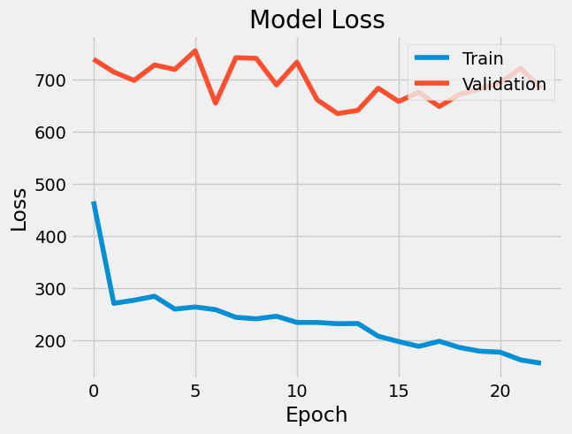
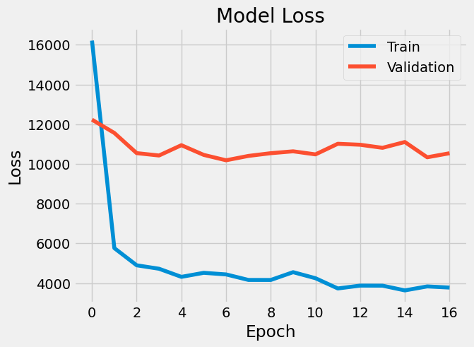
Model Performance
Weekly Sequence
Monthly Sequence
MAE Weeks: 121.34397
Test Loss Weeks:14724.5019
MAE Months: 63.2876
Test Loss Months:4005.47924
Notes:
Next, the Random Forest Model exhibits an accuracy of 48.61% with a MAE of 0.86, signifying its accuracy in predictions. The model stands out for its sensitivity in identifying non-scorers and balancing class imbalances. The feature importance plot underscores 'goal_per_game' as the dominant predictor. This model's predictive power shines through in successfully identifying Mohamed Salah as the top scorer.

Slide 18
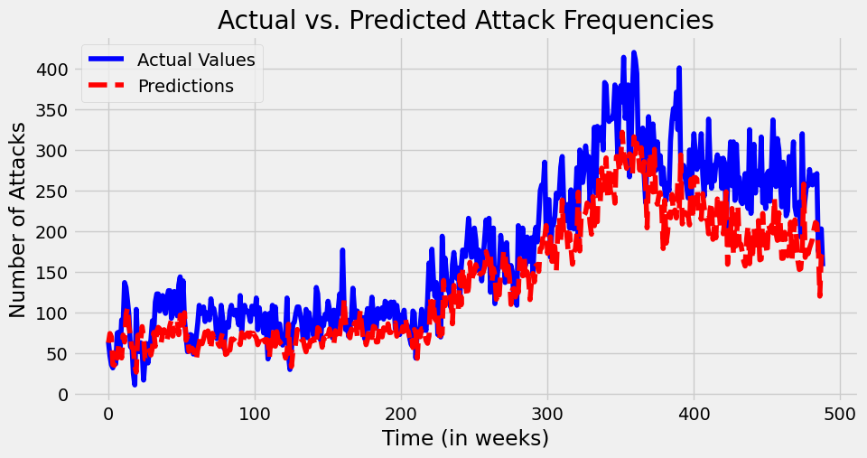
Notes:
These scatter plots compare our models' predicted goals against actual goals. Model 1's plot shows potential, but Models 2 and 3 demonstrate greater accuracy, as seen in the close clustering around the best-fit line, with Salah's prediction being particularly accurate.

Slide 19
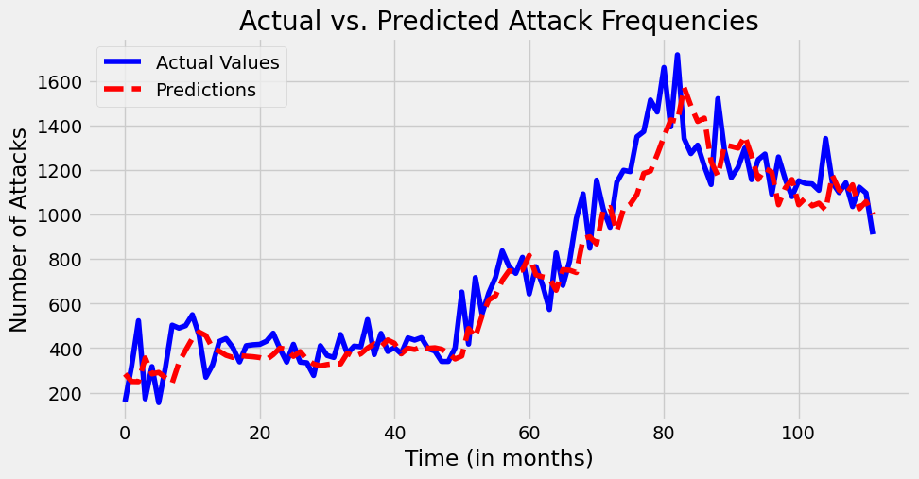
Notes:
These scatter plots compare our models' predicted goals against actual goals. Model 1's plot shows potential, but Models 2 and 3 demonstrate greater accuracy, as seen in the close clustering around the best-fit line, with Salah's prediction being particularly accurate.

Slide 20
GCN Model
GNNs in Counterterrorism:
Graph Neural Networks (GNNs) offer advanced tools to understand the web of connections within terrorism-related activities.
By creating nodes and edges representing various entities and their relationships, GNNs help in uncovering underlying patterns and structures.
Advantages of GNNs:
Able to capture the relational information between different entities.
Identify not just visible patterns but also infer hidden structures in the network.
Provide insights into operational modes and potential hierarchies in terrorist organizations.
Application in this Project:
My project leverages GNNs to predict attack patterns and pinpoint key influencers in terrorist networks.
By analyzing these connections, we aim to provide actionable intelligence for counterterrorism efforts.
Notes:
Our Boosting Model, a Gradient Boosting Machine, holds a solid ground with an accuracy of 55.75% and a MAE of 0.795, showing its ability to make close predictions. It's engineered with a nine hundred trees and depth of 5, finely tuned to pick out 'goal_per_game', 'shots' as important features. Notably, it spotlighted Mohamed Salah as the top goal scorer, which is a testament to the model's effectiveness.

Slide 21
Node Representation and Influence in GNN
Nodes and Edges Overview:
Nodes represent distinct entities such as specific dates of attack, locations, and types of attacks.
Edges create connections between these entities, like linking dates to locations and locations to attack types, establishing a comprehensive network of interrelated data.
Node Types:
Date Node: Signifies the occurrence of an event on a particular date.
Location Node: Encompasses a detailed geographical area of an event.
Attack Type Node: Classifies the nature of the terrorist act.
Edge Types:
Date to Location Edge: Denotes that an attack took place at a certain location on a specified date.
Location to Attack Type Edge: Reveals the nature of the attack at a given location.
Influential Nodes Analysis:
Most Influential Attack Types:
Bombing/Explosion: Significant due to its high frequency and impact.
Armed Assault and Assassination: Indicative of operational tactics.
Key Locations:
'Iraq, Middle East & North Africa, Baghdad': A hotbed for terrorist activities.
'United Kingdom, Western Europe, Belfast': Historical significance and recurring events.
Notes:
Our Boosting Model, a Gradient Boosting Machine, holds a solid ground with an accuracy of 55.75% and a MAE of 0.795, showing its ability to make close predictions. It's engineered with a nine hundred trees and depth of 5, finely tuned to pick out 'goal_per_game', 'shots' as important features. Notably, it spotlighted Mohamed Salah as the top goal scorer, which is a testament to the model's effectiveness.

Slide 22
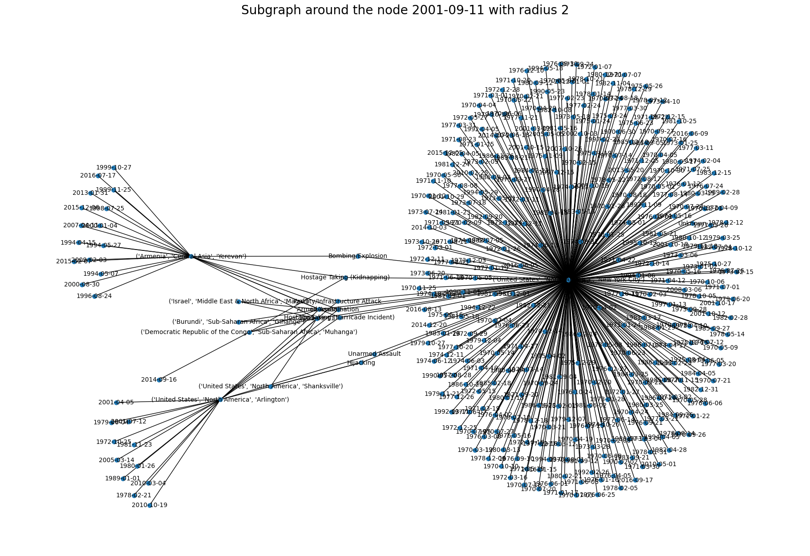
Notes:
These scatter plots compare our models' predicted goals against actual goals. Model 1's plot shows potential, but Models 2 and 3 demonstrate greater accuracy, as seen in the close clustering around the best-fit line, with Salah's prediction being particularly accurate.

Slide 23
Graph CNN Architecture
Feature Preparation
Model Architecture
Categorical Features:
· Utilized OneHotEncoder for one-hot encoding categorical variables.
· Key features include AttackType, Target_type, Weapon_type, and Country.
Numerical Features:
· Normalized numerical data using StandardScaler.
· This includes features such as latitude, longitude, Killed, and Wounded.
Binary Features:
· Binary attributes like IsHoliday, claimed, suicide, and success were kept in their original form.
City Feature Vectors:
· Applied Word2Vec to generate city feature vectors, each represented by a 100-dimensional vector.
Input Layer: Node features with associated edge list.
Hidden Layers: Two layers to enable feature propagation through the graph.
Output Layer: Designed for multi-class classification, with one output per attack type.
Activation Function: ReLU for non-linearity.
Dropout Rate: Set at 0.5 to prevent overfitting.
Loss Function: Cross-Entropy Loss to handle multi-classification tasks.
Optimizer: Adam algorithm for efficient stochastic optimization.
Training Process:
The model underwent a rigorous training regime over 200 epochs, with progress guided by the training mask.
Model's performance was meticulously evaluated using a test mask to ensure robust validation.

Slide 24
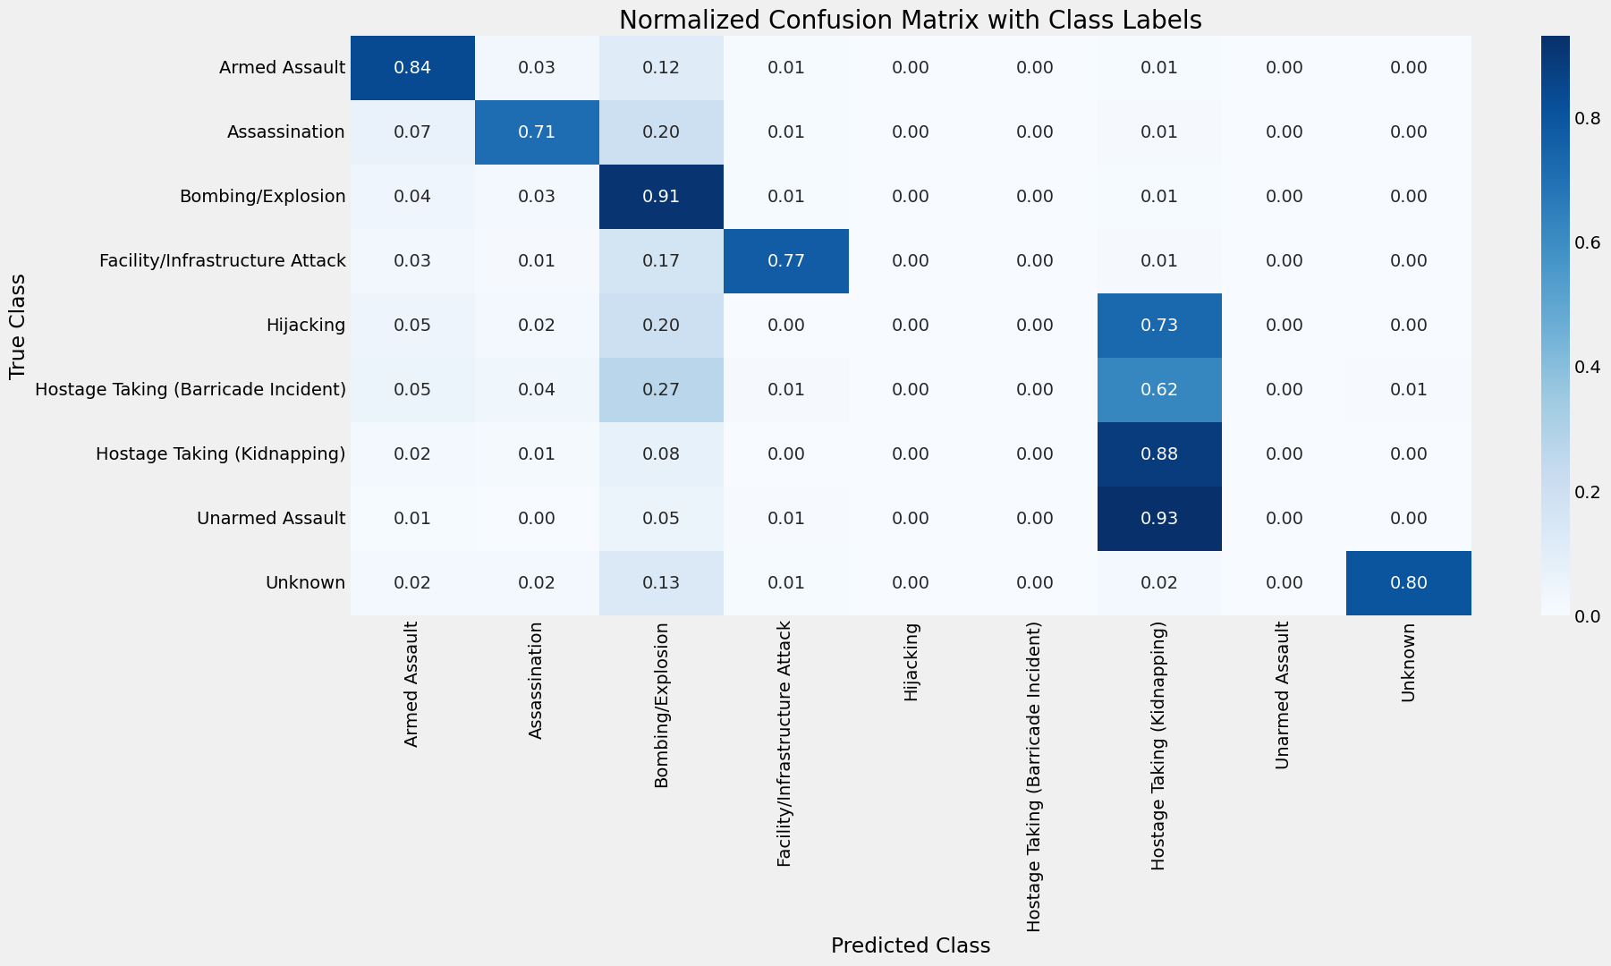
Notes:
These scatter plots compare our models' predicted goals against actual goals. Model 1's plot shows potential, but Models 2 and 3 demonstrate greater accuracy, as seen in the close clustering around the best-fit line, with Salah's prediction being particularly accurate.

Slide 25
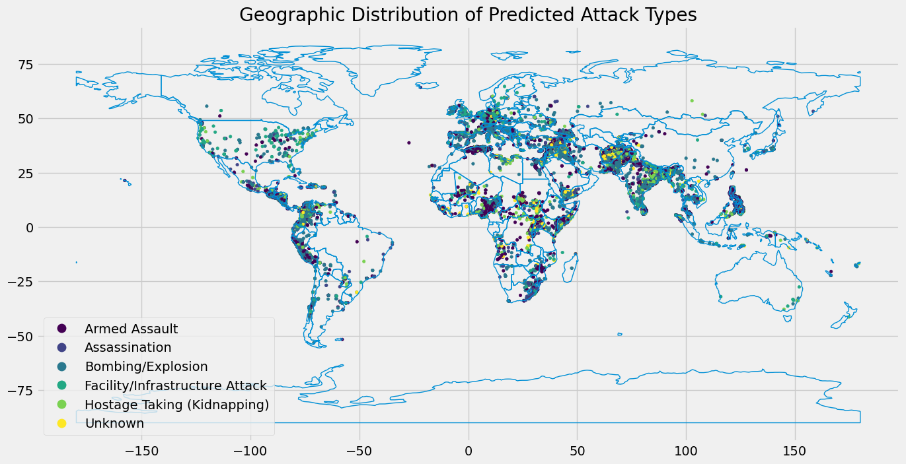
Notes:
These scatter plots compare our models' predicted goals against actual goals. Model 1's plot shows potential, but Models 2 and 3 demonstrate greater accuracy, as seen in the close clustering around the best-fit line, with Salah's prediction being particularly accurate.

Slide 26
Limitations
Managing and preprocessing a large, unbalanced dataset presented initial hurdles, including dealing with missing data and ensuring the integrity of temporal sequences.
The complexity of terrorism data required sophisticated modeling to capture the nuances and unpredictability of the patterns within.
Training deep learning models was tricky. I had to carefully adjust settings and consider the model's design to balance how well it worked and how well it would handle new data.
Future Research
Integrating real-time data streams could further enhance the model's predictive accuracy and timeliness.
Exploring the incorporation of additional context-specific features, such as political events or regional conflicts, may provide deeper insights.
Further experimentation with hybrid models that combine LSTM and GNN could yield a more holistic view of terrorist activities.
Notes:
Here, we're discussing the limitations and future directions for football performance prediction models. Key challenges include data constraints, model bias, overfitting risks, and the dynamic nature of football. To improve, we must expand datasets, address biases, and adapt models for dynamic scenarios. Shifting focus to early-career potential, incorporating more data, and collaborating with sports scientists offer promising avenues. In conclusion, overcoming these challenges and adopting interdisciplinary approaches will enhance the accuracy and applicability of our models. Thank you."

Slide 27
Conclusion
Achievements:
Successfully addressed the high-dimensionality challenge inherent in terrorism data, reducing it to actionable intelligence.
Demonstrated the feasibility and efficacy of using LSTM and GNN to forecast and analyze terrorism trends.
Showcased the adaptability and robustness of the models through rigorous validation, achieving commendable accuracy and insight.
Project Impact:
The project's deep learning framework offers a cutting-edge tool for security agencies to anticipate and mitigate the risks of terrorist attacks.
By forecasting trends and identifying critical nodes within terrorist networks, the model supports strategic decision-making and policy development.
The insights gained from the analysis have the potential to guide resource allocation, enhance surveillance, and inform public awareness efforts.
Notes:
As we wrap up our presentation, we reflect on our key findings. The Boosting Model emerged as the leader in predictive accuracy, setting a benchmark for future analyses. This speaks to the potential of machine learning in transforming football strategy, with data-driven insights paving the way for smarter decision-making
To stay ahead in the fast-evolving field of sports analytics, we must embrace new technologies and methodologies that can further enhance our predictive capabilities.
We are at the cusp of a new era in sports analytics, where the integration of advanced models like the Boosting Model can lead to unprecedented success on the football field. Let's continue to push the boundaries and aim for the podium of analytical excellence in sports.

